Slide 1
Multi-Scale Self-Supervised Consistency Training for Trustworthy Medical Imaging Classification
Bonian Han¹, Cristian Moran², Gongbo Liang²
¹Hangzhou Dianzi University, Hangzhou, China
² Texas A&M University-San Antonio, San Antonio, TX, USA
Notes:
Good morning, everyone! My name is Bonian Han; I am presenting our work, Multi-Scale Self-Supervised Consistency Training for Trustworthy Medical Imaging Classification.
Since the early 2010s, modern neural network models have demonstrated exceptional capabilities in various medical diagnosis tasks. Computer scientists are excited about the potential neural network-powered Computer-Aided Diagnosis tools.
[next page]

Slide 2
Neural network-powered CADs are exciting! But…
Can we trust them in medical practice?
Notes:
However, even the tools often have a near-human performance in the literature. A natural question often asked by the medical team is, “Can we trust them?”
[next]

Slide 3
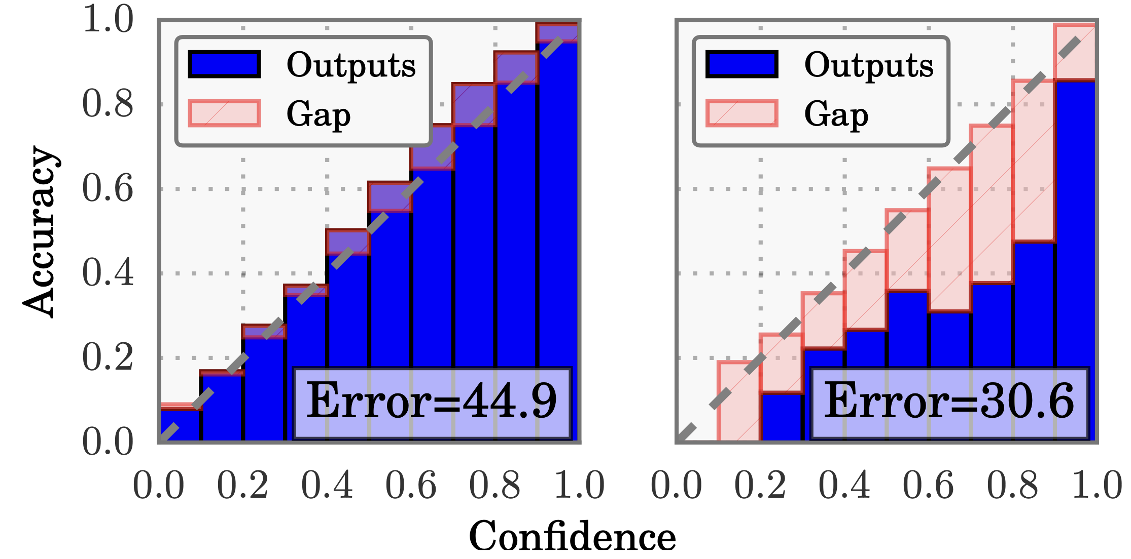
Modern Neural Networks are often poorly calibrated!
Guo, Chuan, Geoff Pleiss, Yu Sun, and Kilian Q. Weinberger. "On calibration of modern neural networks." In International conference on machine learning, pp. 1321-1330. PMLR, 2017.
Notes:
Well… Here is a figure from a pioneer work showing that modern deep neural networks are often poorly calibrated, even though they often have significantly better accuracy than the old neural networks.
The left figure shows a conventional neural network model with only five layers. The model has 44.9% of error or 55.1% of accuracy, which is significantly lower than the right figure. The right figure has an accuracy of almost 70%.
However, when considering the model calibration, the right one is actually much worse than the left one. The bins in each figure indicate the model calibration. For a well-calibrated model, all the bins should align on the diagonal line.
We can see the bins in the left figure are much closer to the diagonal line than the right one. This shows even the model has a worse performance than the right one, the left one is much better calibrated.
[next page]

Slide 4

Miscalibration = Estimate Uncertainty Wrong
E.g.,
For any binary classification tasks, given 100 predictions with an average confidence of 0.95, we would expect around 95 correct predictions.
$$ℙ\left(\hat{y}=y | \hat{p}=p\right)≠P$$
In reality, a model with 0.95 confidence often has less accuracy than 95%.
Notes:
A poorly calibrated model often estimates its uncertainty wrongly.
For instance, for any binary classification tasks, given 100 predictions with model estimated confidence of 0.95, we would expect around 95 correct predictions.
[click] However, in reality, a neural network model with 0.95 confidence often has less accuracy than 95%.
For instance, in our experience, we trained a ResNet model on pneumonia detection. The model shows an average of 96% confidence in its prediction. But, the real performance is only about 83% accuracy. There is a 13% gab between the accuracy and the estimated confidence of the predictions.
[next page]

Slide 5

Miscalibrated modes provide…
$$ℙ\left(\hat{y}=y | \hat{p}=p\right)≠P$$
In reality, a model with 0.95 confidence often has less accuracy than 95%.
Misleading information that might lead to catastrophic consequence
Notes:
Miscalibrated models are problematic in medical diagnosis because such models provide misleading information to healthcare experts.
Such misleading information may lead to catastrophic consequences, such as costing human lives.
[next page]

Slide 6
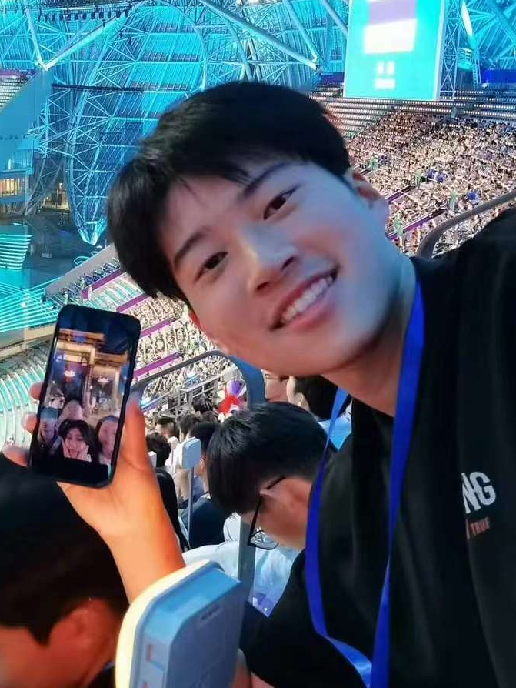

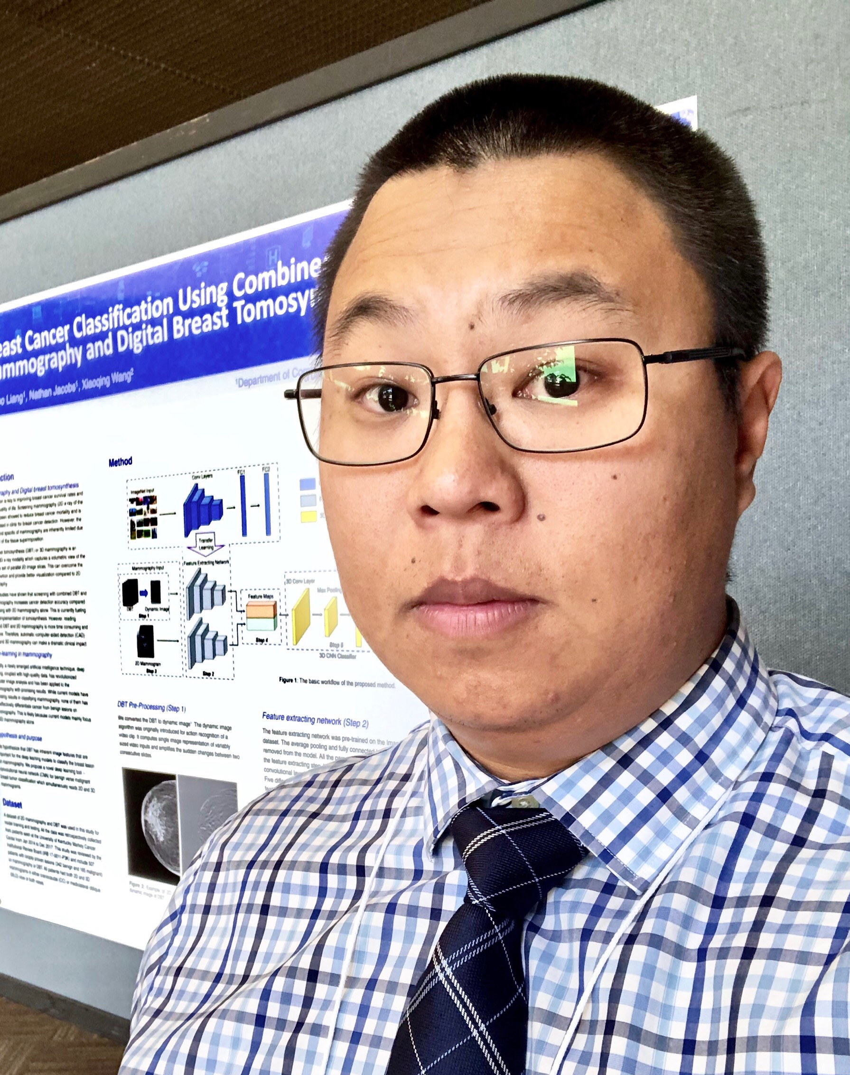
Multi-Scale Self-Supervised Consistency Training for Trustworthy Medical Imaging Classification
Bonian Han¹, Cristian Moran², Gongbo Liang²
¹Hangzhou Dianzi University, Hangzhou, China
² Texas A&M University-San Antonio, San Antonio, TX, USA
Notes:
Through this project, we propose a novel neural network calibration framework that utilizes multi-scale input images and integrates self-supervised consistency enforcement during training. The proposed framework is applicable to diverse imaging modalities and foundational models.
[Next page]

Slide 7
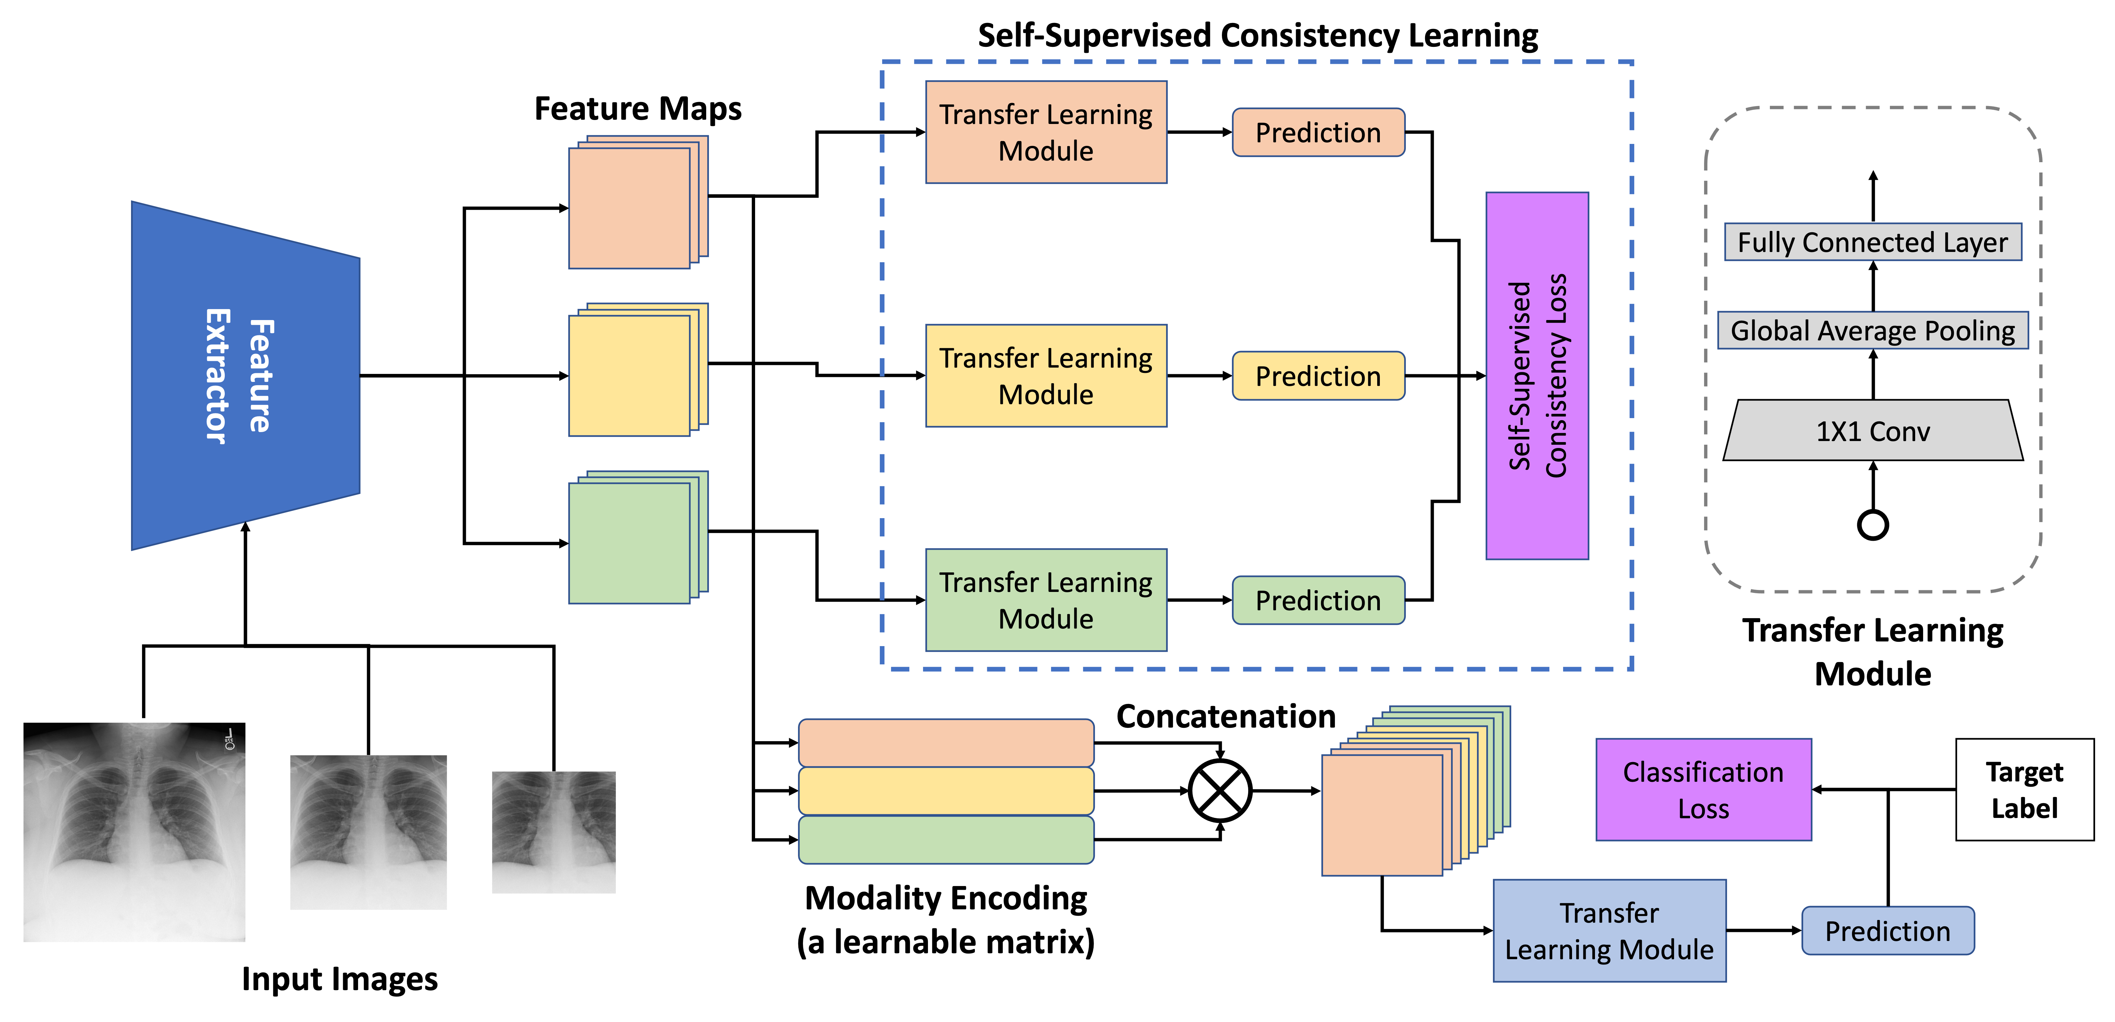
Proposed Architecture
Notes:
Here is our architecture. In general, our method contains four main components
[next page]

Slide 8
Multi-Scale Input Generation
Generates k sub-views of an input image by applying random crops.
The k+1 views, including the original one, are then fed into the shared feature extractor.
Notes:
The first component is a multi-scale input generation method.
Given an input image, such as a chest x-ray, we first randomly crop multiple sub-views of this image.
[next page]

Slide 9
Shared Feature Extractor
A feature extractor is shared between all the k+1 views.
The k+1 feature maps are fed to the Self-Supervised Consistency Learning module and the Main Predicting Head.
Notes:
Then, we feed all the sub-views and the original image to a shared feature extractor. This feature extractor could be any CNN model or Transformer model.
The outputted feature maps will be used in the next two components.
[next page]

Slide 10
Self-Supervised Consistency Learning
Contains k+1 auxiliary prediction heads, one for each view.
KL divergence is used as the loss to measure the consistency of the prediction of every two auxiliary heads
Notes:
The extracted feature maps will be first fed into the self-supervised consistency learning model.
The module contains multiple prediction heads. The number of prediction heads is equal to the number of feature maps.
One prediction head only receives the feature map from one view.
Each prediction head is a smaller classification model.
Since all the views are from the same input image, we expect all the prediction heads to give the same predicted label, regardless of whether they are correct or not.
We use KL divergence as the loss to measure the consistency of the predictions of every two prediction heads
[next page]

Slide 11
Main Predicting Head w/ Modality Encoding
Modality Encoding
A learnable (k+1) x 8
Provide information about the views in the multi-scale input set
Concatenated with the corresponding feature maps
The concatenated feature maps are used as input for the final prediction.
Notes:
Lastly, we feed the extracted features to the main predicting head.
The main predicting head contains a modality encoding module and a small classification model.
The modality encoding module is a learnable matrix that provides information about the views in the multi-scale input set. The weights of the modality encoding matrix is learned during the training.
We concatenate the feature map of each view with the corresponding row in the modality encoding matrix. Then, the concatenated feature maps are used as the input for the final prediction
[next page]

Slide 12
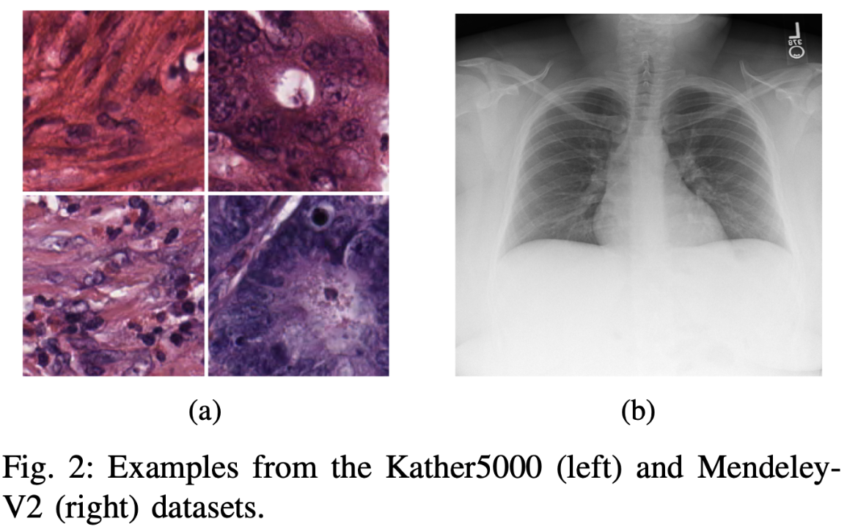
Experiment Setup
Dataset
Architecture
ResNet-50
Evaluation Metrics
ECE – Expected Calibration Error
The most common metric for calibration
F1 Score
Precision
Recall
Name | Imaging Modality | # of Images | # of Classes
Mendeley | Chest X-Ray | 5856 | 2
Kather | Histological | 5000 | 8
Mendeley
Kather
Notes:
We evaluate the proposed method using ResNet-50 on two medical imaging datasets.
The Mendeley kids pneumonia dataset contains 5856 images for two classes.
The Kather is a histological dataset that has 5000 images for 8 different classes.
We evaluate the models' performance using four evaluation metrics.
The expected calibration error is the most common metric used to measure model calibration.
In addition, we also measure the models using the F1 score, precision, and recall.

Slide 13
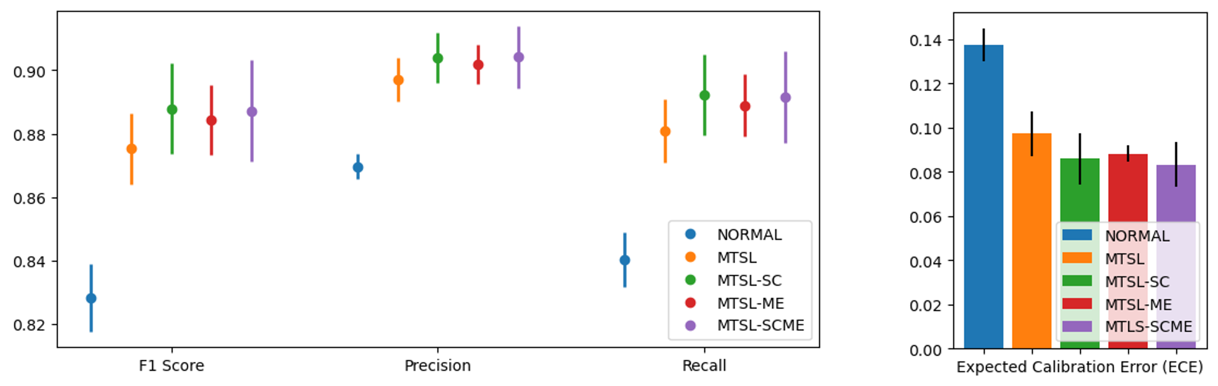
Result -- Mendeley
SINGLE: The ResNet-50 model with Image-Net pre-training
MTSL: The ResNet-50 model with multi-scale input
MTSL-SC: The ResNet-50 model with multi-scale input & self-supervised consistency module
MTSL-ME: The ResNet-50 model with multi-scale input & modality encoding
MTSL-SCME: The proposed model
Notes:
This figure shows our evaluation result on the Mendeley dataset for a binary classification task.
The “SINGLE” model is fine-tuned using an image-net pre-trained ResNet-50. The model reaches about 0.83 F1 score but has about 0.14 ECE for calibration error.
The Yellow bar shows the result of ResNet-50 model with multi-scale input. We can see after adding the Multi-Scale Input to the ResNet-50 model, the model performance is significantly improved to about 0.88 F1. And the calibration error is also reduced to about 0.1 ECE.
The Green and Red bars show the result of the ResNet-50 model with multi-scale input and self-supervised consistency module or modality encoding, respectively. The figure shows the performance are be further improved.
Finally, the Purple bar achieves the best performance, which shows the proposed model. It has the highest value on all the measurements.

Slide 14
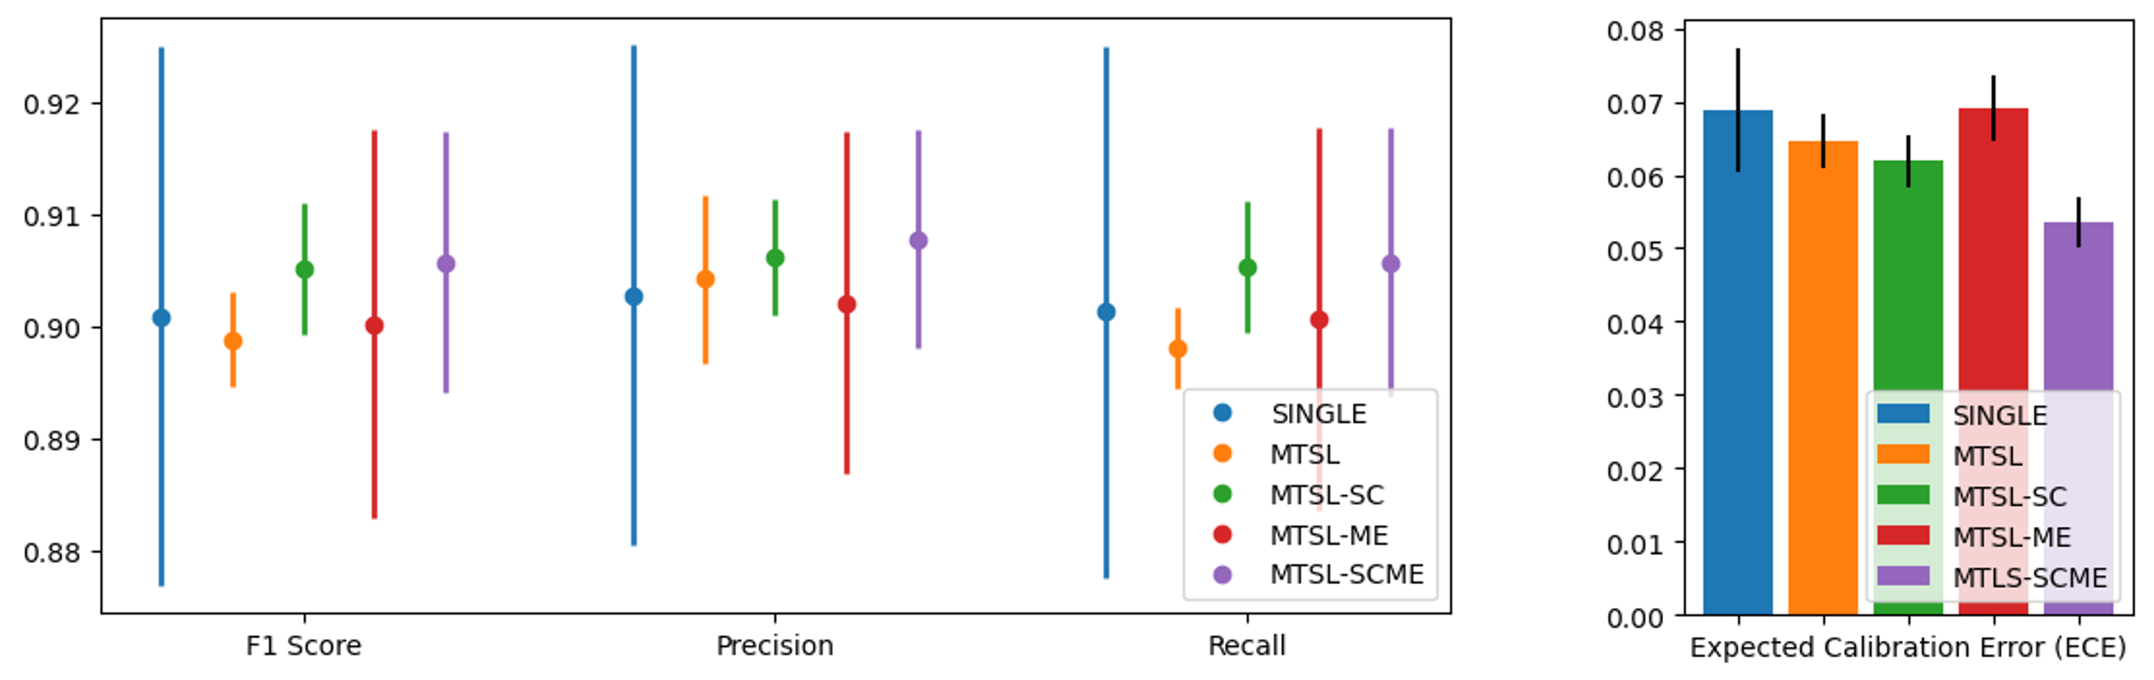
Result -- Kather
SINGLE: The ResNet-50 model with Image-Net pre-training
MTSL: The ResNet-50 model with multi-scale input
MTSL-SC: The ResNet-50 model with multi-scale input & self-supervised consistency module
MTSL-ME: The ResNet-50 model with multi-scale input & modality encoding
MTSL-SCME: The proposed model
Notes:
This figure shows our evaluation result on the Kather dataset for multi-class classification.
In the ResNet model, the blue bar has a good performance in terms of accuracy. But, we can see the error bar has quite a large range, indicating the model performance is not very stable across multiple runs. Also, comparing with other models, we also see the ResNet has the highest ECE value and widest error bar.
Also, similar with the previous example, the proposed method is able to significantly improve the model performance and calibration again.

Slide 15
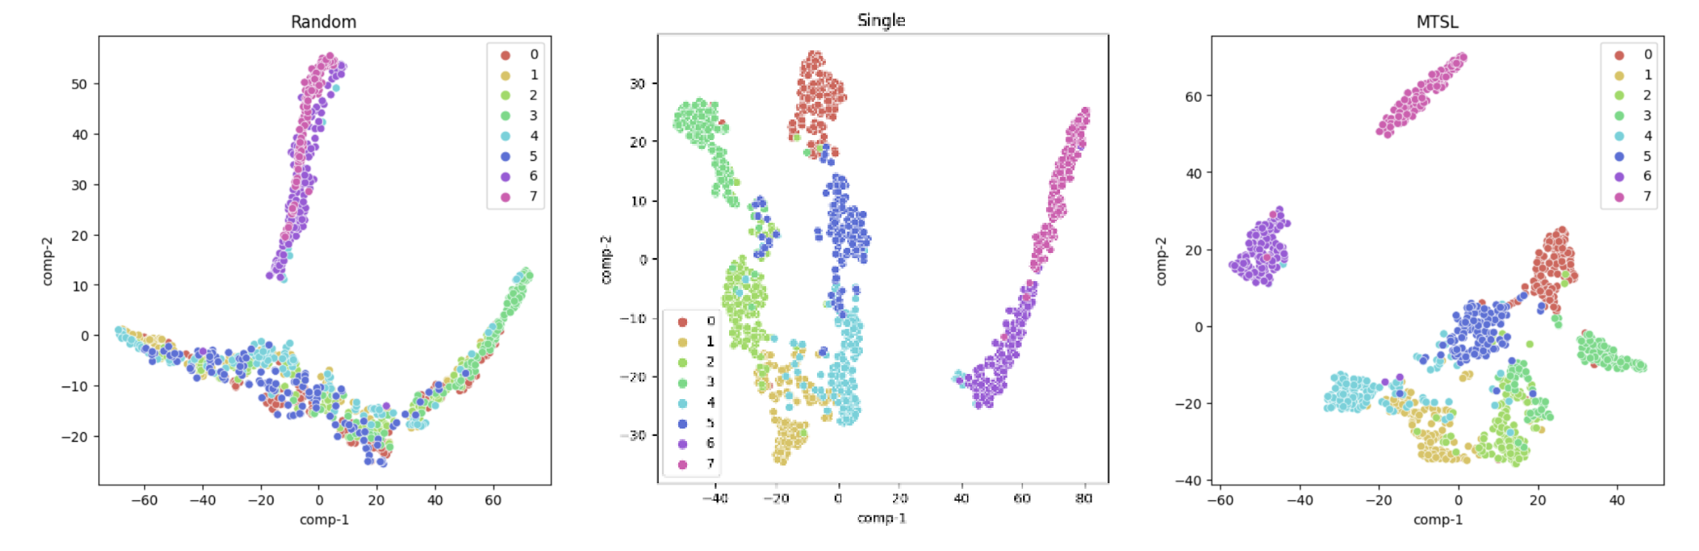
T-SNE for Feature Space Visualization (Kather)
Random Model
Image-Net Pre-Trained ResNet-50 Model
ResNet-50 with
Multi-Scale Input
Notes:
This figure shows the learned feature space of different models using the t-SNE plot. Each dot is a sample, and the color indicates the label of the sample.
We can see when initializing a model with random weights (left), all the samples are formed into two clusters. It is hard to separate samples based on their classes.
But, when an initial model with Image-Net pre-trained weights (middle), the samples are more separatable.
However, when initializing the model with our model (right), the 8 classes are better separated.
Thus, we believe the feature space learned by our model has better representability than the conventional methods.

Slide 16
Conclusion

Slide 17
Thank you!
Questions?

